Slide 1

Rehabilitation Robotics
MakerCamp| Ekaterina Ivanova

Slide 2
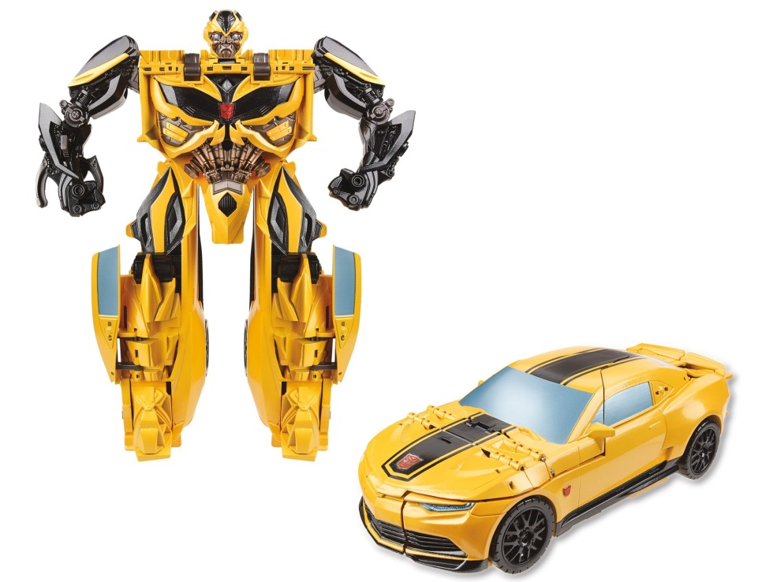
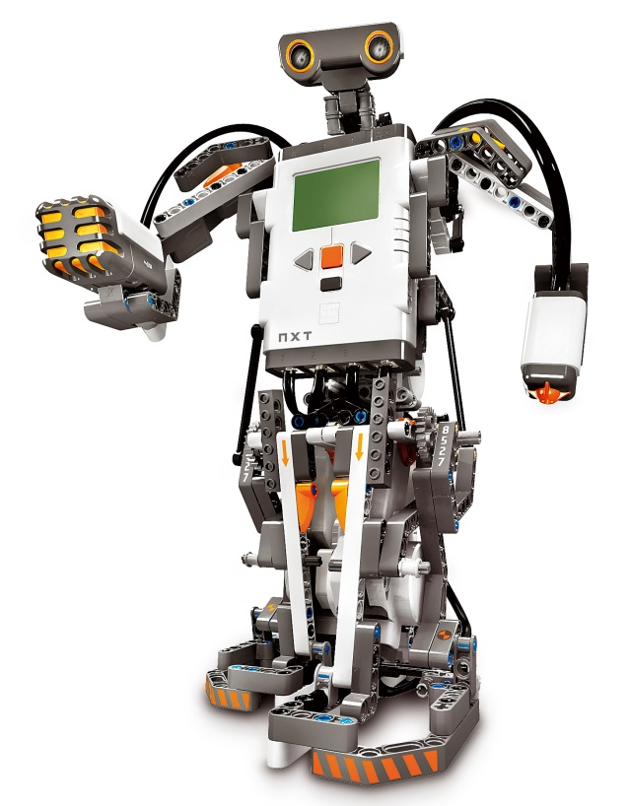
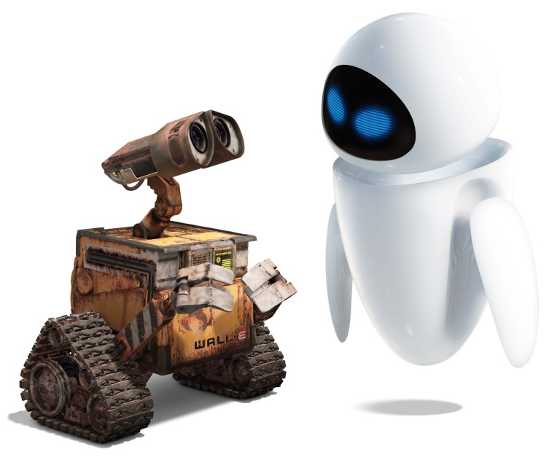
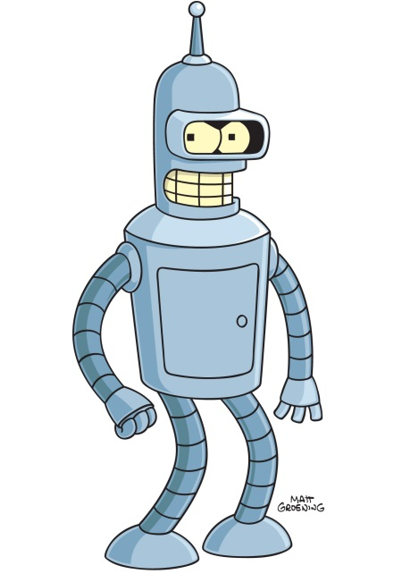
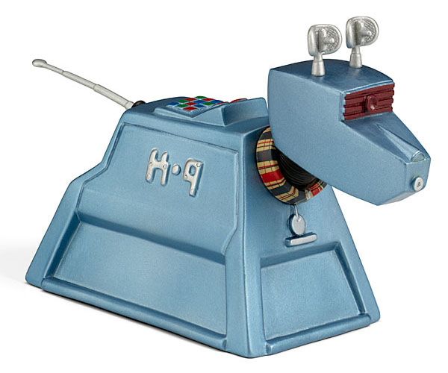
MakerCamp | Ekaterina Ivanova

Slide 3
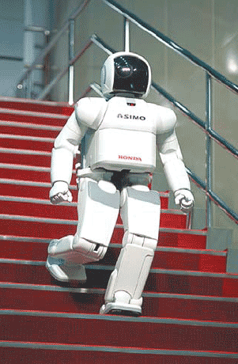
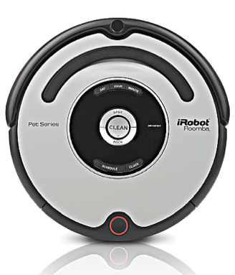
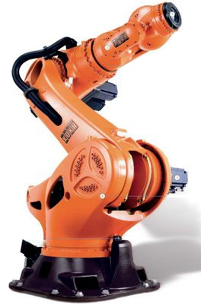
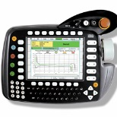
Robots
Humanoid robots
Service robots
Industrial
robots
iPhone control
Tablet control
MakerCamp | Ekaterina Ivanova

Slide 4
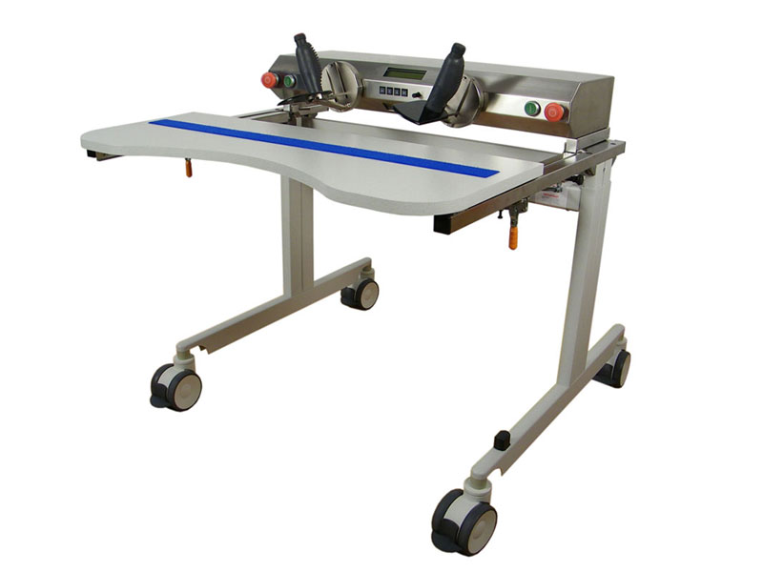
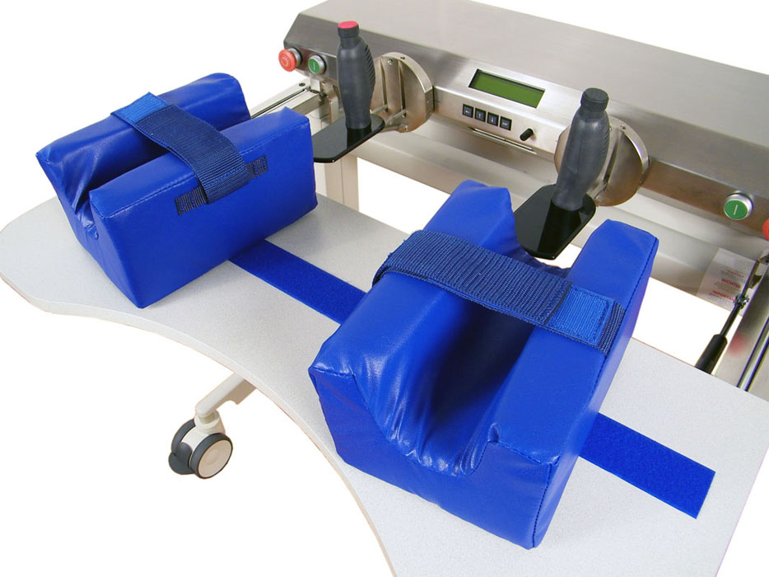
Rehabilitation robots
BiManuTrack (c) RehaStim
MakerCamp | Ekaterina Ivanova

Slide 5
1
Motivation
MakerCamp | Ekaterina Ivanova

Slide 6
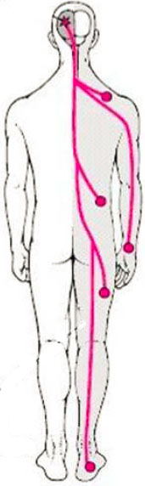
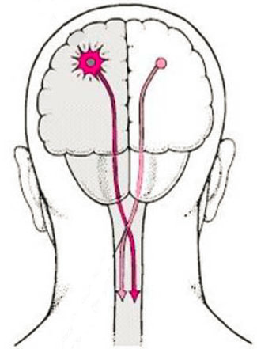
Stroke
1. Motivation
Loss of brain funktions
Reason:
lack of blood flow,
internal bleeding
Consequences:
lost of sensorimotor
functions of one side of the
body,
cognitive disorders
http://docvadis.de/
MakerCamp | Ekaterina Ivanova

Slide 7
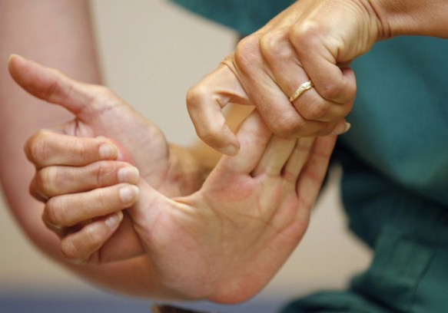
Conventional therapy
1. Motivation
Goal: Evoke the brain plasticity
1: 1 interaction patient-therapist
Motor Relearning Program (MRP):
high-intensity
task-specific
repeated
execution of the movements
(Kwakkel et al., 1999), (Langhammer, 2000)
http://guardianlv.com/
MakerCamp | Ekaterina Ivanova

Slide 8
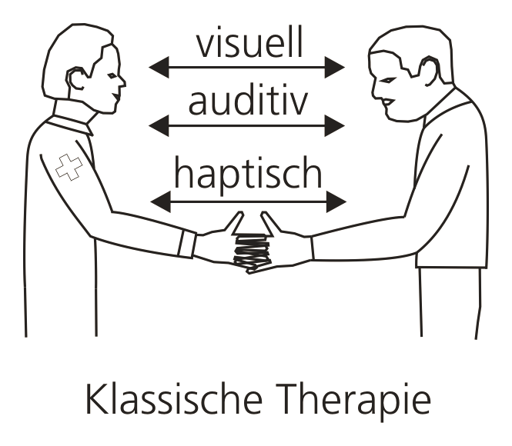
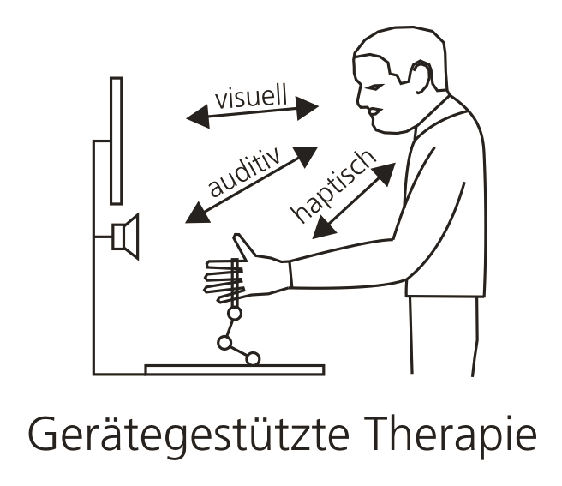
Robotics based therapy
1. Motivation
High effectiveness of treatment
High accuracy of the executed movements
High intensity of training
“Assist-as-needed” support
MakerCamp | Ekaterina Ivanova

Slide 9
2
Robotic devices
MakerCamp | Ekaterina Ivanova

Slide 10
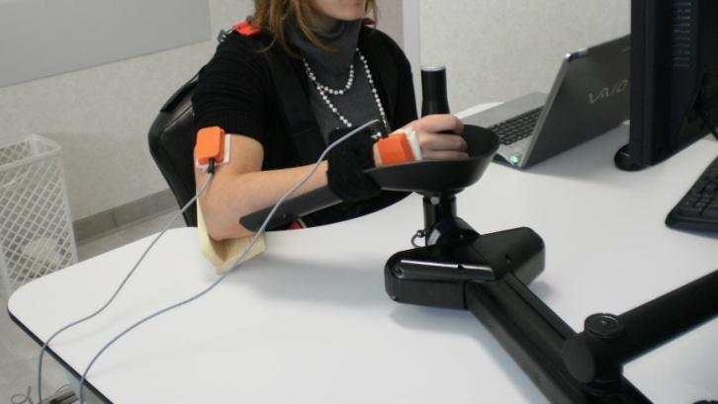
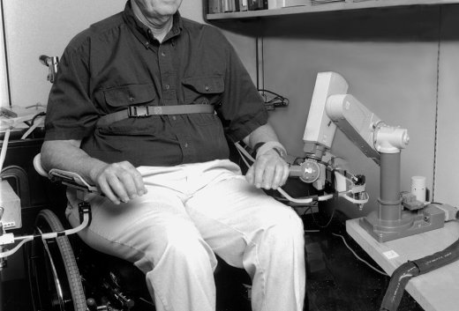
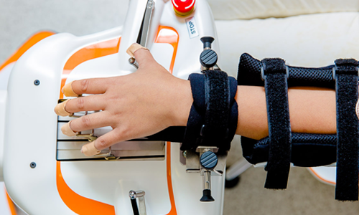
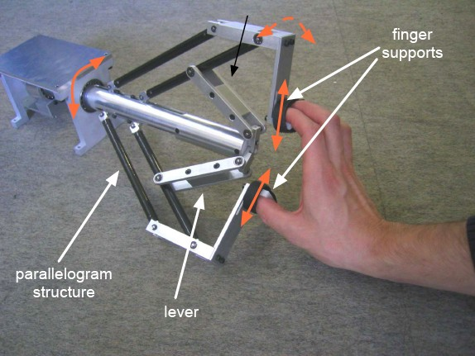
Existing devices
2. Robotic devices
MIT Manus (1998)
MIME
Amadeo
Haptic knob
MakerCamp | Ekaterina Ivanova

Slide 11
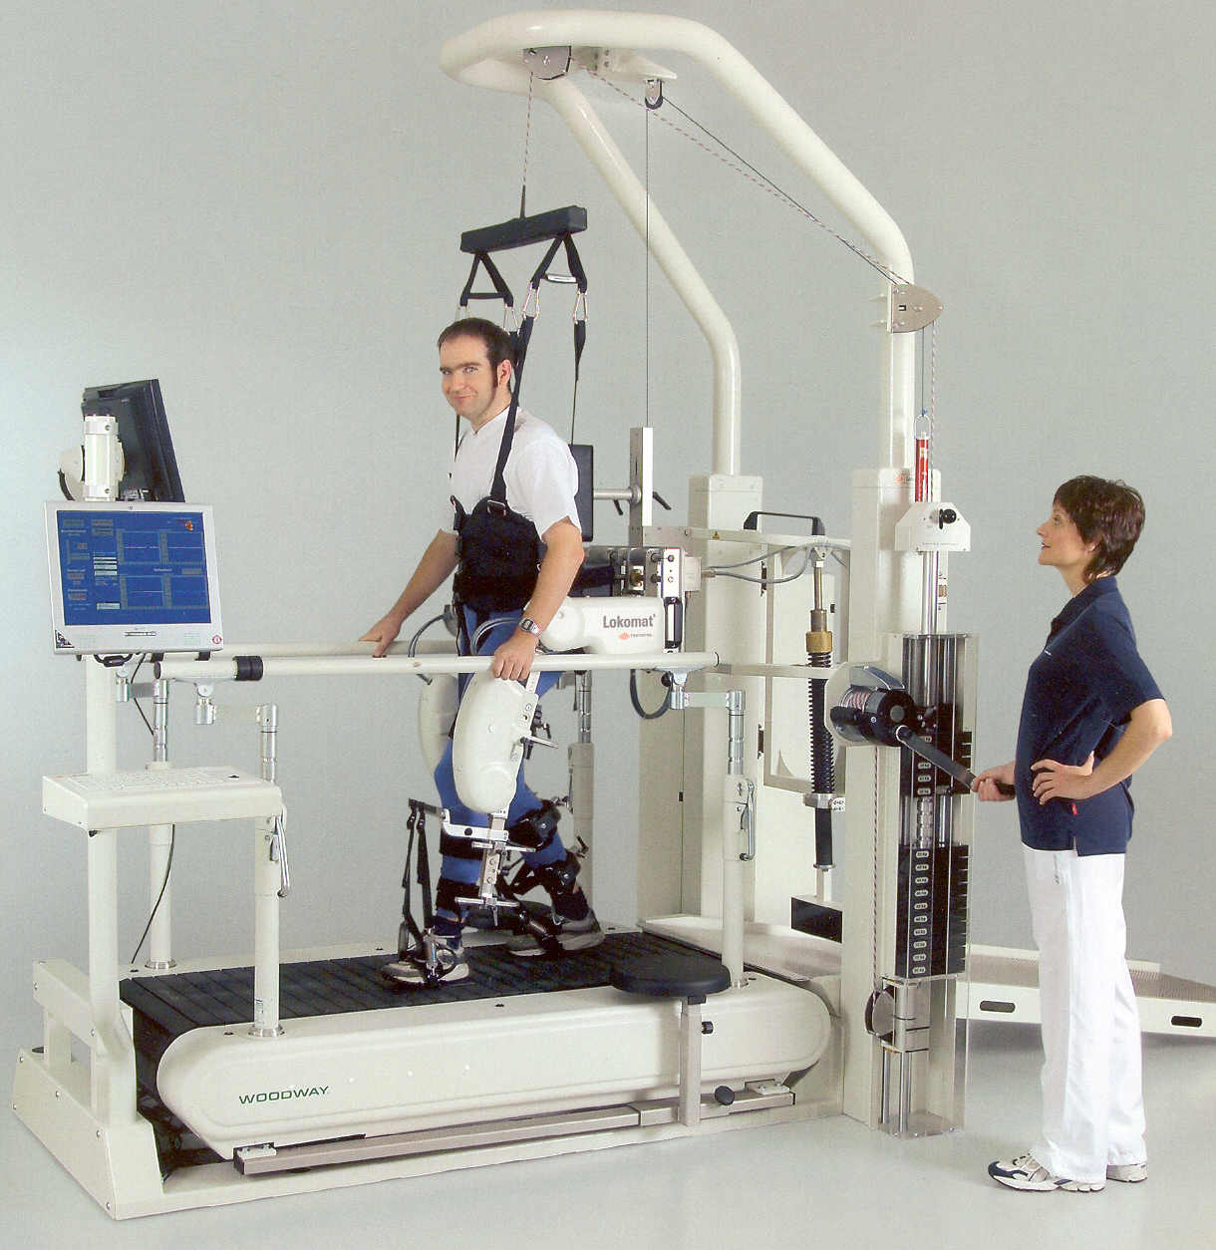
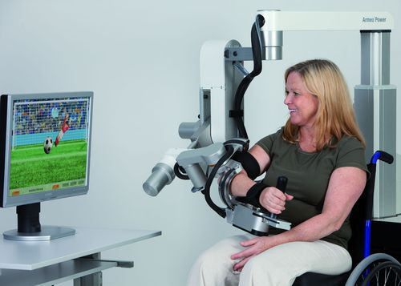
Existing devices
2. Robotic devices
Lokomat
Armeo
MakerCamp | Ekaterina Ivanova

Slide 12
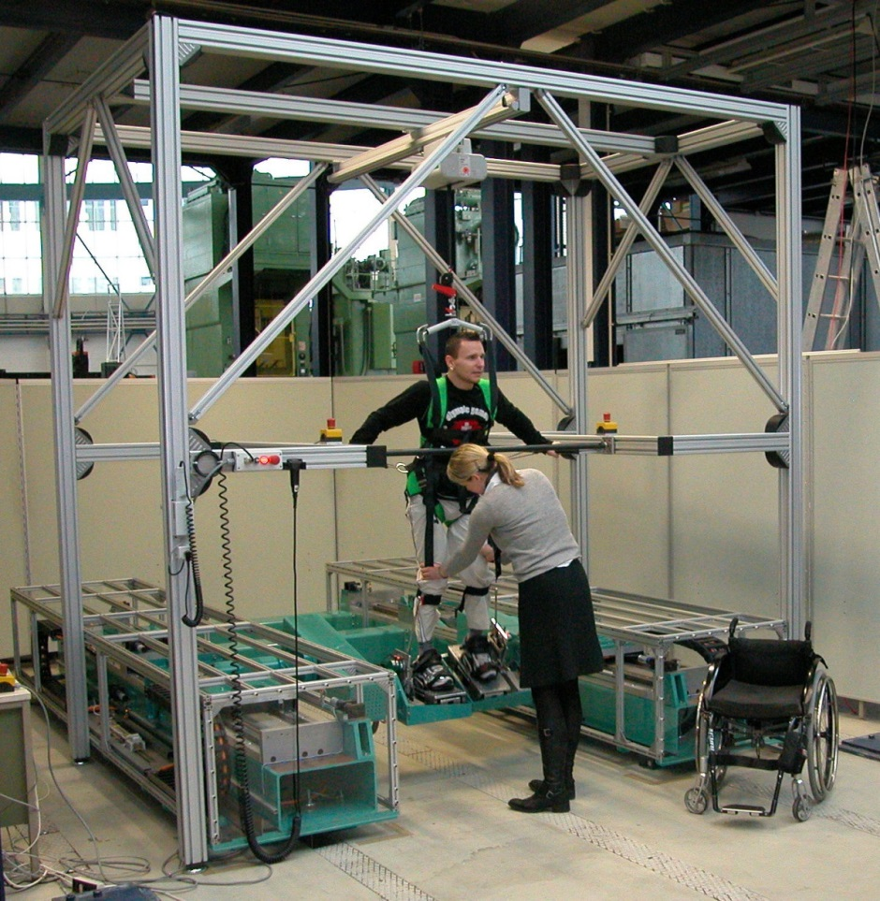
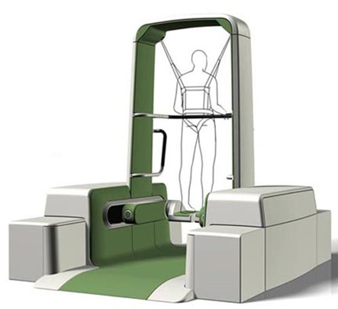
Existing devices
2. Robotic devices
HapticWalker
(c) Fraunhofer IPK & TU Berlin IAT
MakerCamp | Ekaterina Ivanova

Slide 13
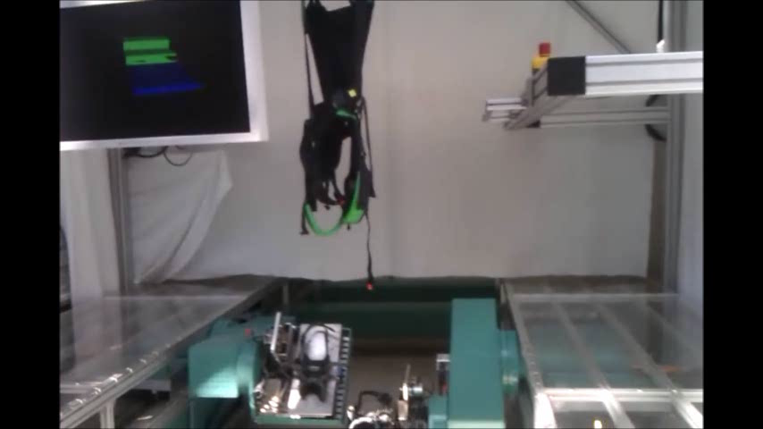
Existing devices
2. Robotic devices
HapticWalker
HaptikWalker Video
(c) Fraunhofer IPK & TU Berlin IAT
MakerCamp | Ekaterina Ivanova

Slide 14
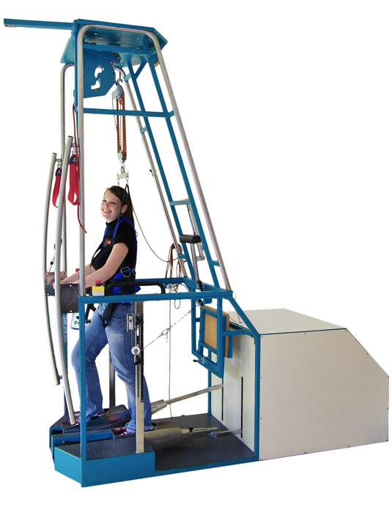
Existing devices
2. Robotic devices
GangTrainer
(c) RehaStim
MakerCamp | Ekaterina Ivanova

Slide 15
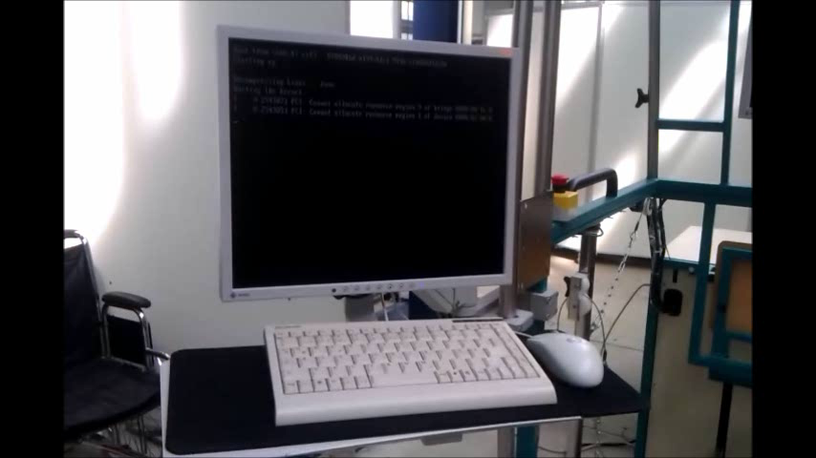
Existing devices
2. Robotic devices
GangTrainer
(c) Fraunhofer IPK & TU Berlin IAT
MakerCamp | Ekaterina Ivanova

Slide 16
3
Current projects
MakerCamp | Ekaterina Ivanova

Slide 17
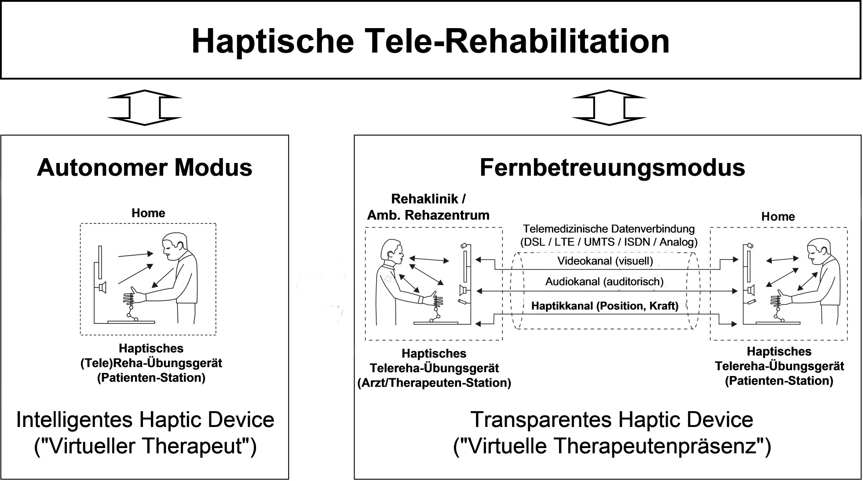
Telerehabilitation
3. Current projects
(c) Fraunhofer IPK & TU Berlin IAT
MakerCamp | Ekaterina Ivanova

Slide 18
Telerehabilitation
3. Current projects
BiManuTrack (c) RehaStim
MakerCamp | Ekaterina Ivanova

Slide 19
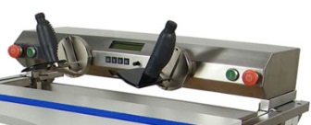
Telerehabilitation
3. Current projects
DB
TCP
RTAI Linux
RTAI Linux
(PI-Controller)
i_{t}, x_{t}
i_{p}, x_{p}
f_{t}
f_{p}
force
sensor
Therapist
GUI
force
sensor
Patient
MakerCamp | Ekaterina Ivanova

Slide 20
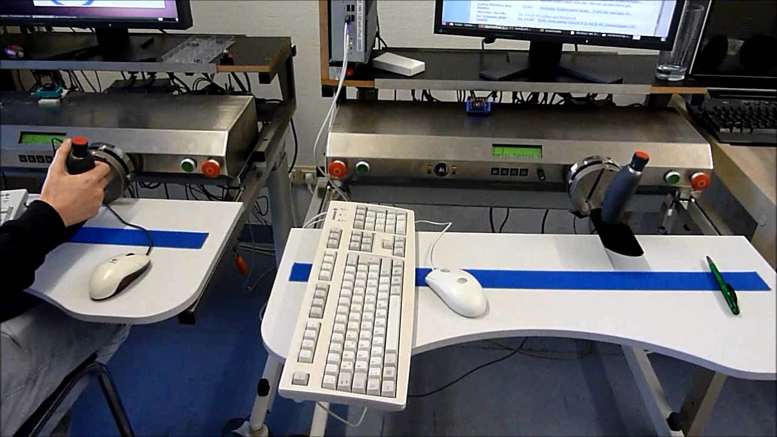
Telerehabilitation
3. Current projects
MakerCamp | Ekaterina Ivanova

Slide 21
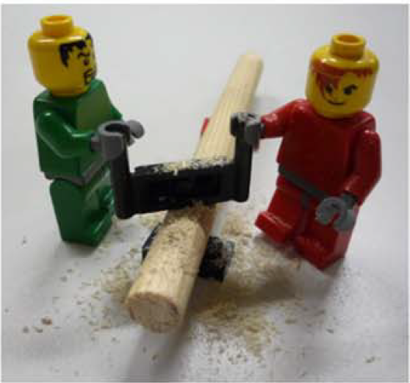
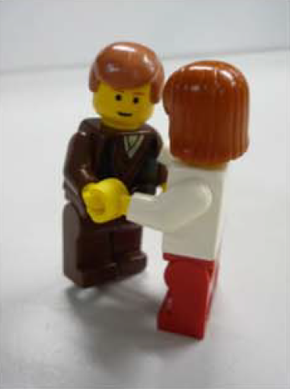
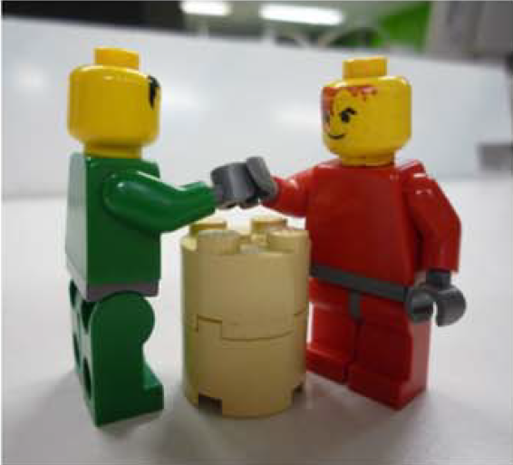
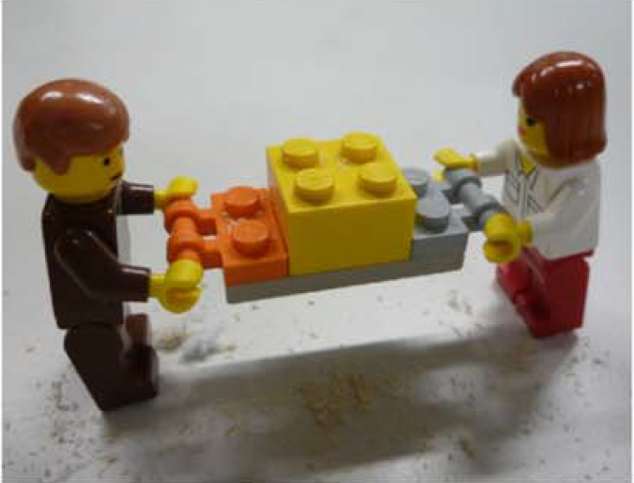
Human-Robot-Interaction
3. Current projects
Jarrassé et al., 2012
MakerCamp | Ekaterina Ivanova

Slide 22
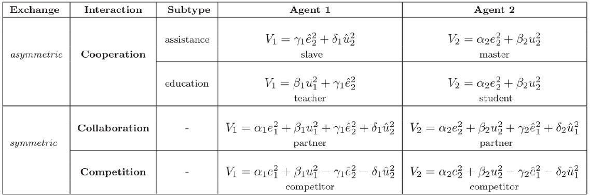
Interactive bevaviors
3. Current projects
Jarrassé et al., 2012
Rehabilitation: education type
MakerCamp | Ekaterina Ivanova

Slide 23
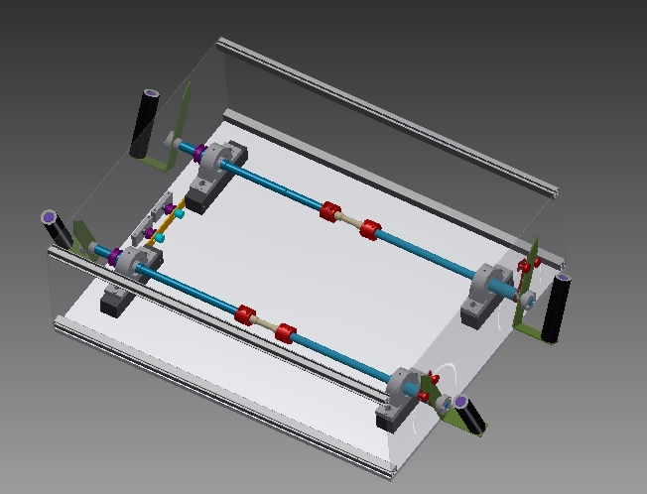
Human-Robot-Interaktion
3. Current projects
Quantitative study of HHI with a goal to build a model of haptic human
behavior and transfer this knowledge into HRI
(c) Fraunhofer IPK & TU Berlin IAT
MakerCamp | Ekaterina Ivanova

Slide 24
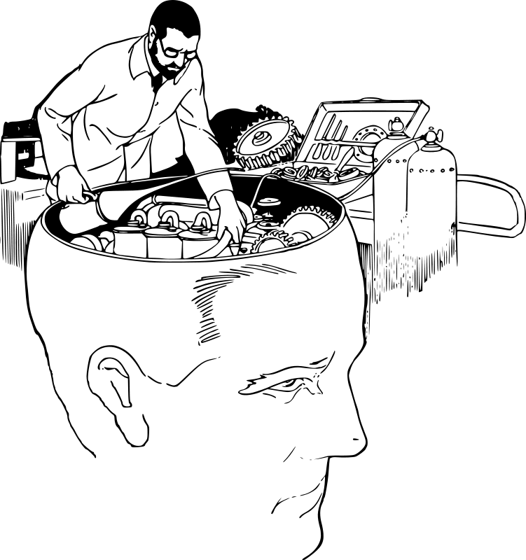
Thank you!
MakerCamp | Ekaterina Ivanova

